Slide 1

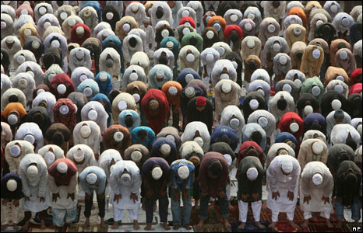
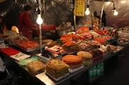
welcome

Slide 2
:
Introduction:
Md: Hasan Ali
Assistant Teacher
Akbar Ali shah High School
Pakerhat,Khansama,Dinajpur.
Subject: English 1st Paper
Class: Nine
Lesson: Eid Mubarok
Unit:4 Date:

Slide 3
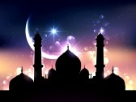
Picture of starting Eid

Slide 4
Learning Out come:After finishing the lesson the learns will able to :
      say about their feeling of meeting different kinds of people.
      change their lives by religious values.
      Develop good relation among themselves.
      make a dialogue about it.
      visit new places on Eid

Slide 5
The picture of praying condition of Muslim.

Slide 6

The picture of embracing

Slide 7
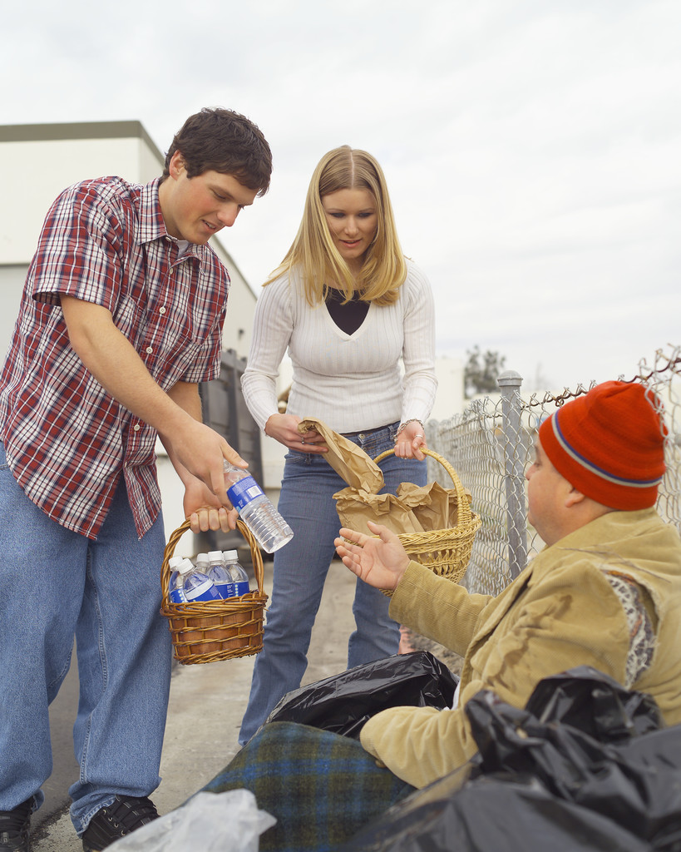
Picture of giving food to the poor people

Slide 8

Picture of visiting new place

Slide 9
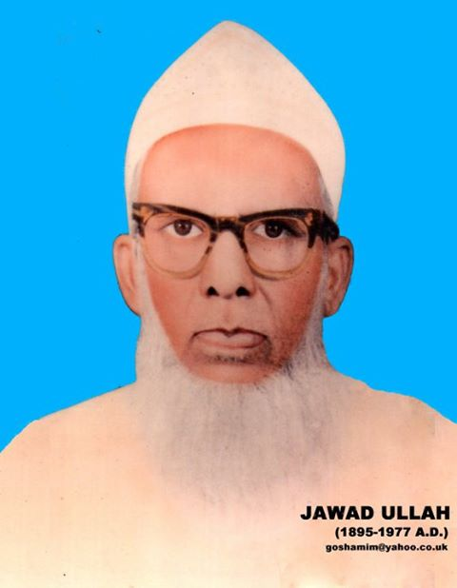
Vocabulary(new words meaning)
Muslim The people who followed all Islam religious
The muslim are brave nation in the world.

Slide 10

Festival funtion of making glady
Eid is the biggest festival in mulim life.

Slide 11

Neighbour The people who live near to close.
The Neighbour are our very relative.

Slide 12
Delicious very tasty
Every body take delicious food in Eid day.

Slide 13
Eidgah It is a place where muslim finish Eid Pray.
                The Eidgah is a nice place for Muslim.

Slide 14
Group Work
1.Describe the gladly feeling among muslims on observing Eid.
2.Write a short paragraph on Eid.

Slide 15
Evualation:
Fill in the blank with suitable Words:
Eid is the ----festival in muslims life.
It--------a great------in human lives .
It teaches to show----- and-------to the poor people.So everybody should build up life,society and world by the all values of Eid Mubaok.

Slide 16
Home Work
Describe the benefit of observing Eid in human life.

Slide 17

Thanks

